Slide 1

ALT YOUTUBE
▶
MAJOR PROJECT BE COMPUTER

Slide 2

Major project group-
NAMES | UIN | ROLL NO
ABDULNABI SHAIKH 🎓 | 201P066 | 43
MOHAMMAD ISMAIL | 201P035 | 46
JAZA PHEGRI | 201P010 | 32
SHAH SALMAN | 201P047 | 41
🎓 → Team Leader

Slide 3

PROBLEM STATEMENT
YouTube addiction is a growing concern, with users spending excessive amounts of time on the platform and being exposed to potentially harmful content.
There is a need for an anti-addiction system that uses Artificial Intelligence and machine learning to identify and limit exposure to addictive content, providing a healthier and more balanced user experience.

Slide 4

OBJECTIVES
To develop an anti-addiction system for YouTube using Artificial Intelligence and machine learning.
To identify and limit exposure to addictive content on the platform.
To provide a healthier and more balanced user experience on YouTube.
To educate users about the potential negative effects of excessive use of the platform.
To offer an alternative to YouTube’s current system that prioritizes user well-being over engagement metrics.

Slide 5

PROPOSED METHADOLOGY
To develop a recommendation system that operates in contrast to YouTube’s existing recommendation system, using a limited dataset.
This new system should recommend videos that are out of context to the user after they have spent a sufficient amount of time viewing.
The system should not interfere with the user’s ability to search for content, meaning that users should still receive accurate search results. However, the recommended videos below the search results may not be related to the video being viewed.

Slide 6

OUR
The project will involve training a dataset of approximately 10,000 YouTube videos on various topics.
A web application will be developed for the new system.
User will be encouraged to involve in more physical activities rather that using smartphone.
Timely lag will be featured in the application in order to make the user to leave the application.

Slide 7
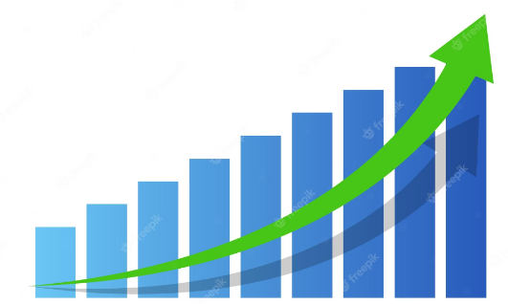
Steps
Survey
Planning
Developing the model
Deployment
Testing
Integration
Making the application

Slide 8


Slide 9
THANK
YOU🙏

